Slide 1
Introduce to MyMap
Map is designed to provide a router recorder for the ones who want keep a track of where they went and the experience they have at that moment. And at the same time provide a function for them to go to where they want at any time.

Slide 2
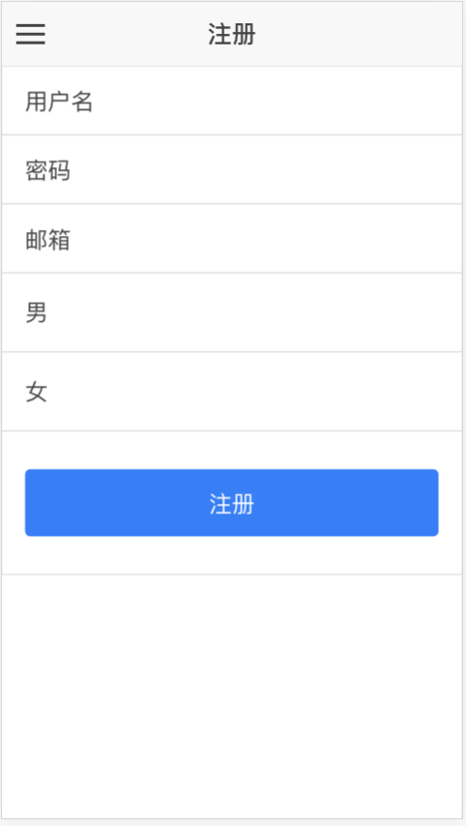
Register Page
You can register your account here.

Slide 3
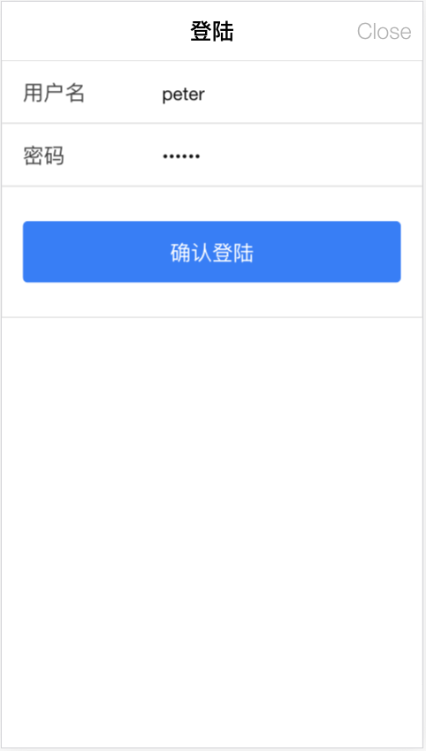
Login Page
Login in to get the authentication on server.

Slide 4
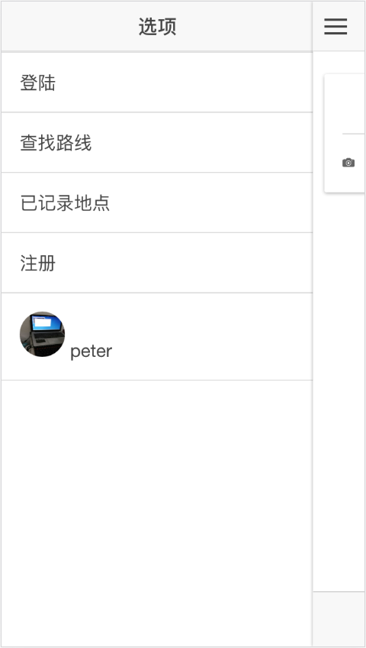
After Login
You can see your picture and name on the left slide.

Slide 5
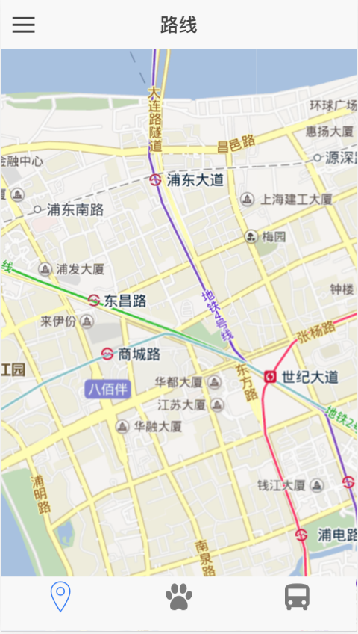
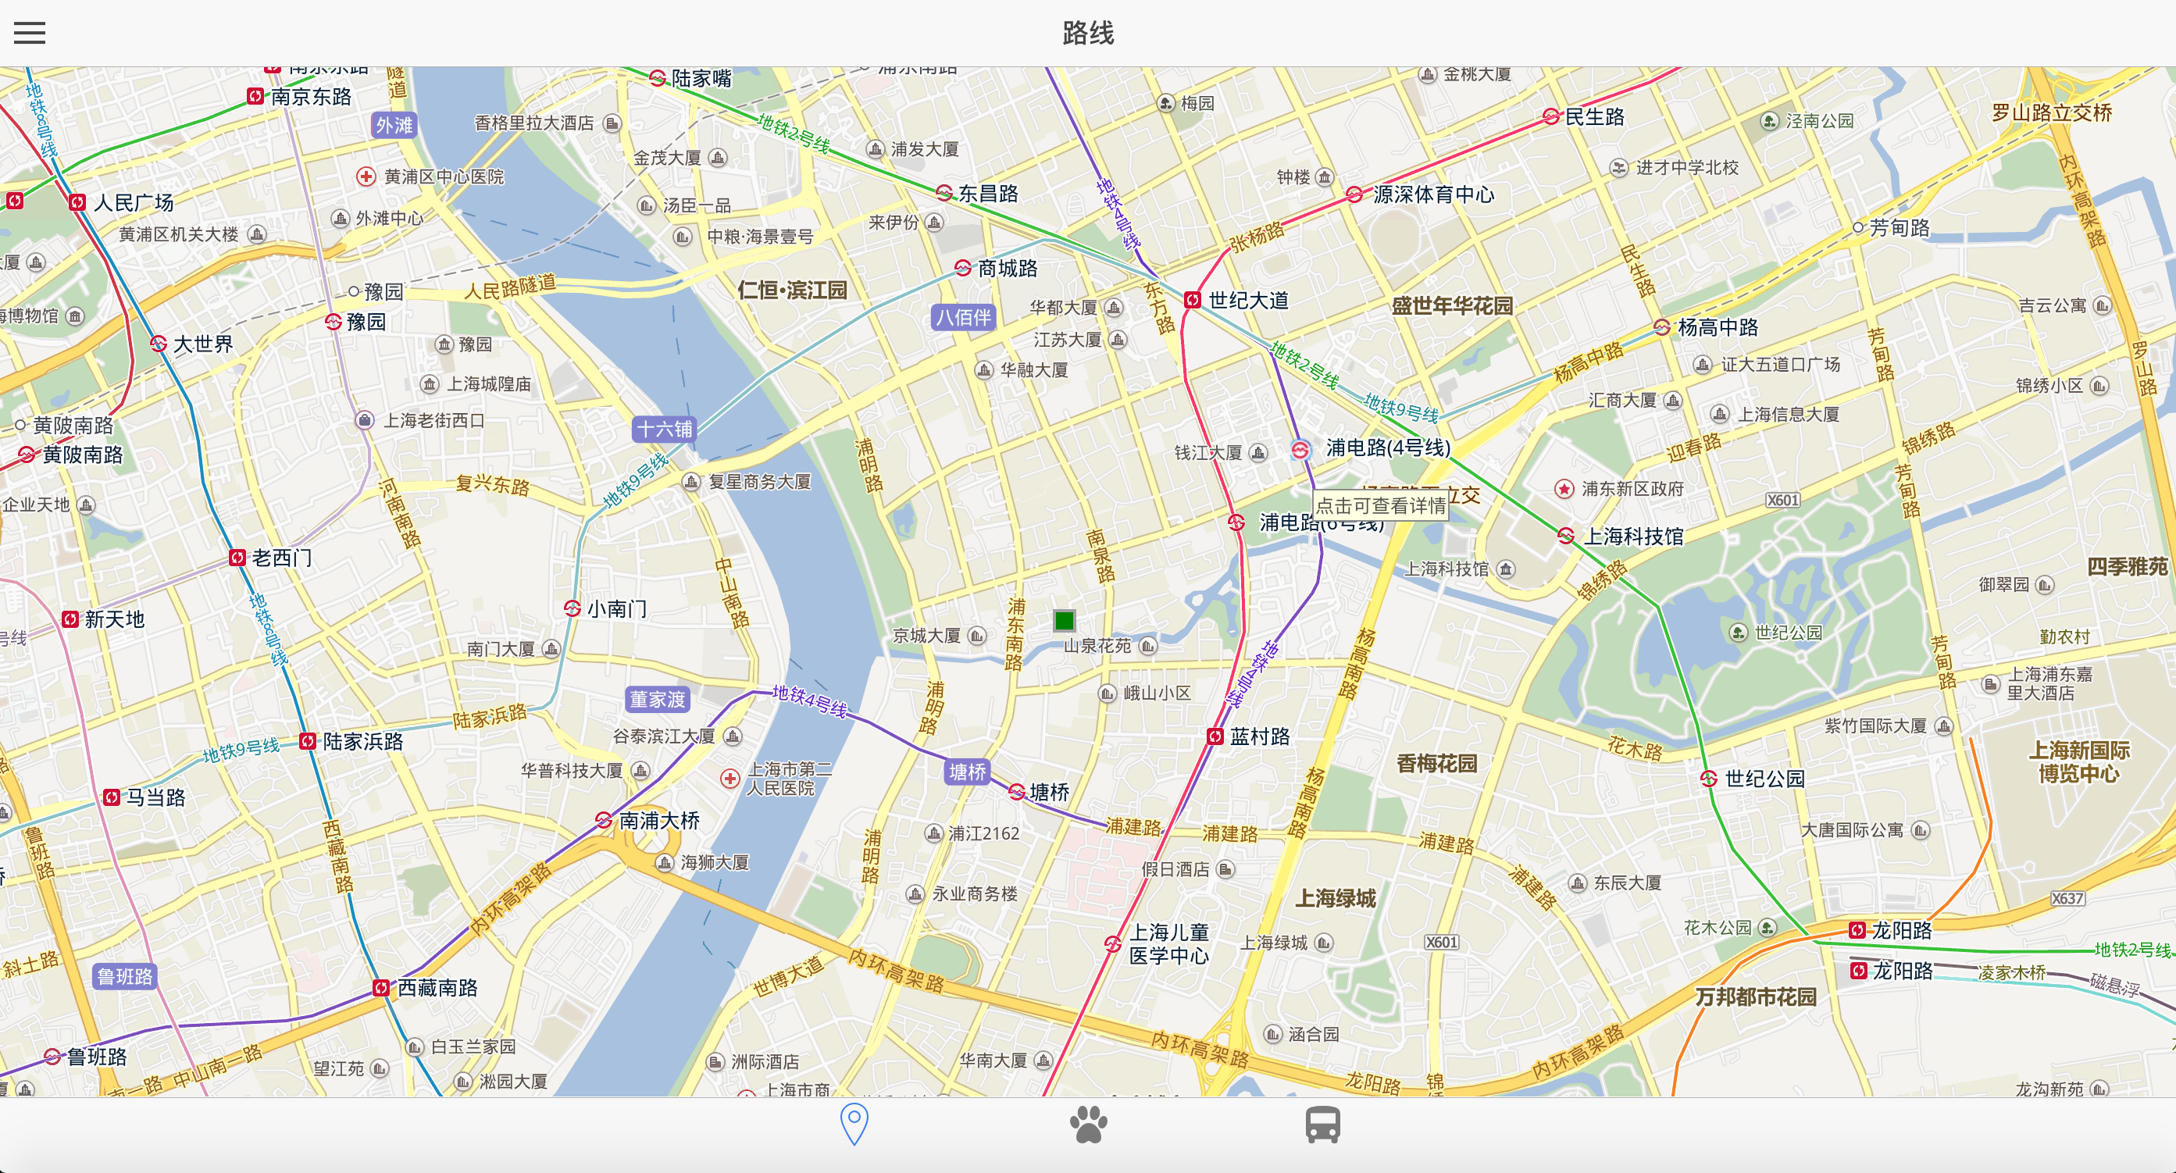
Get your current location
Enter the serach route page, and get you current location.

Slide 6
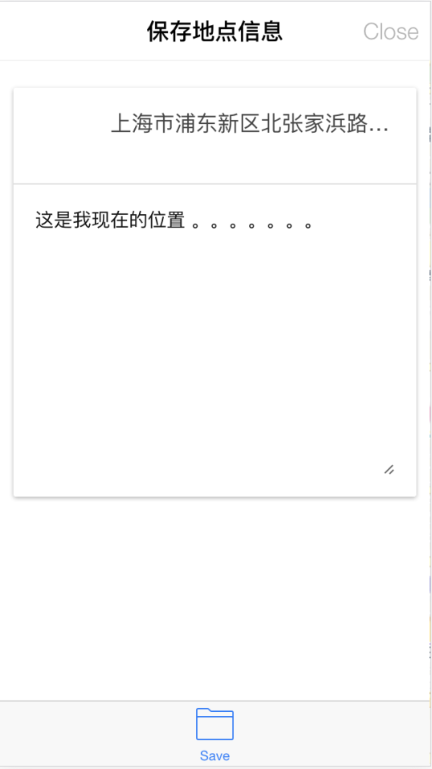
Save your current location
Save your location here.

Slide 7
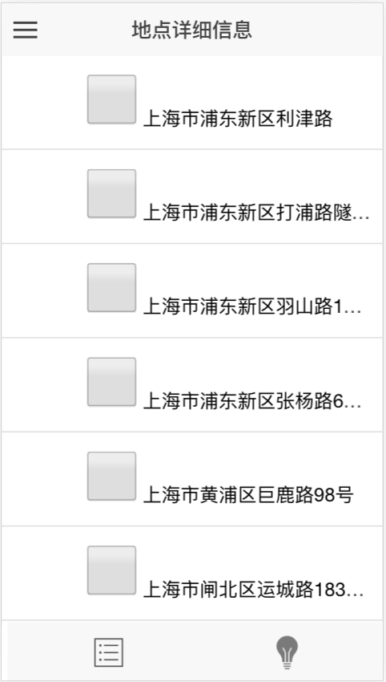
Go to the saved location list
You can get your saved location list here.

Slide 8
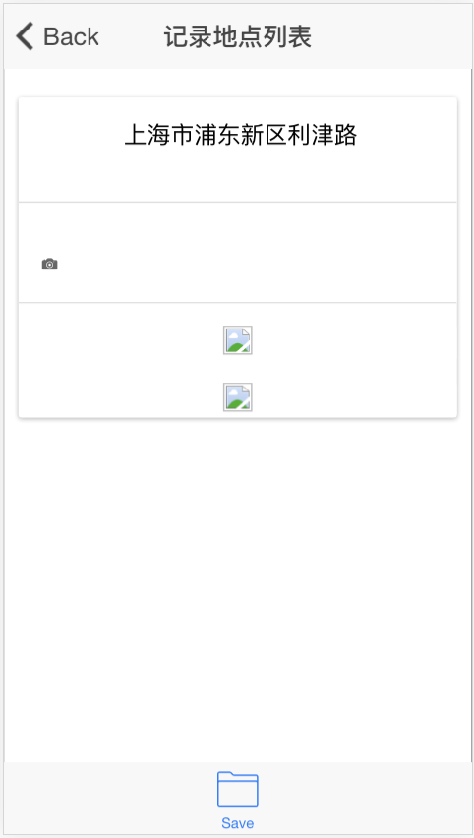
Update you location info
You can click the location list’s item to enter the update location information page. In here you can upload your location’s picture.

Slide 9
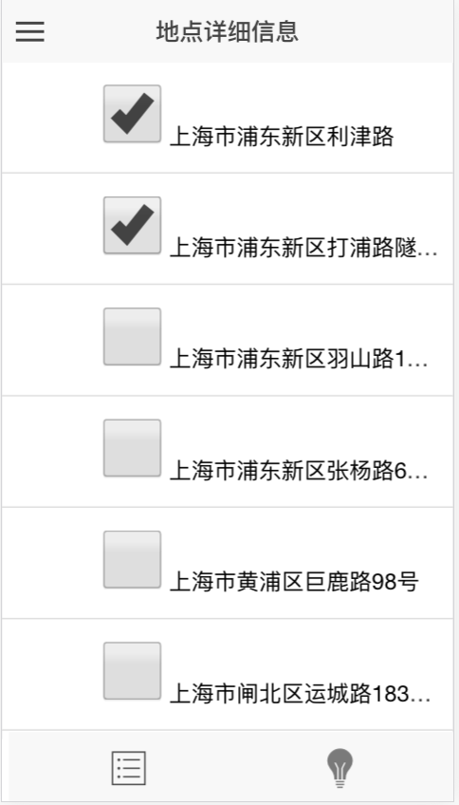
Select locations
Select the locations you want to display on map.

Slide 10
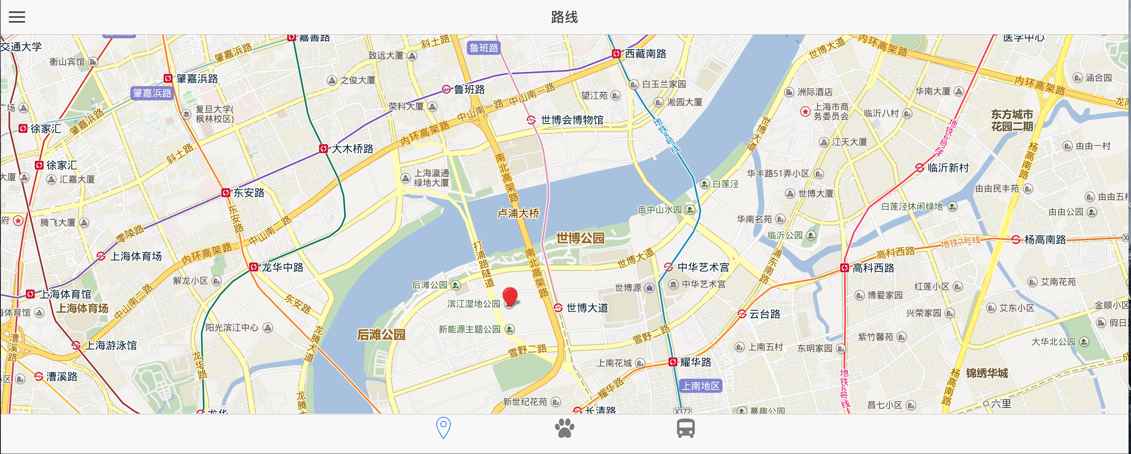
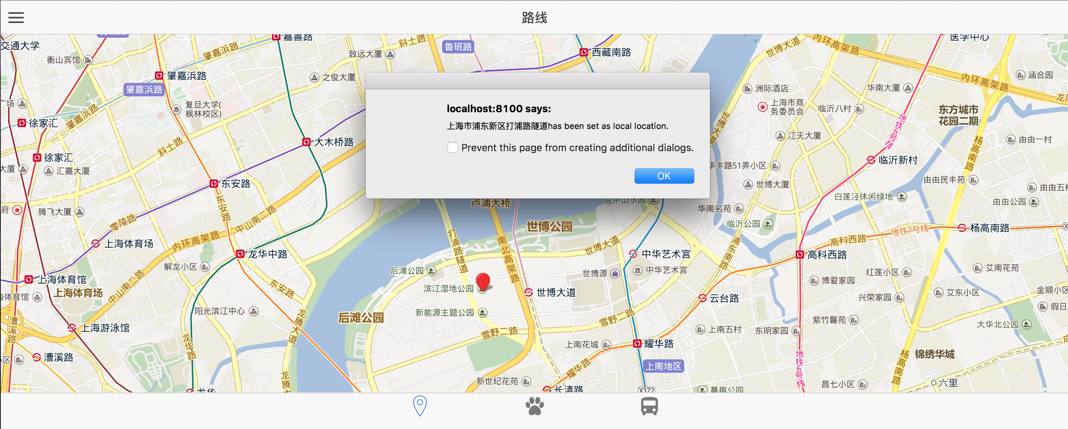
Find the location
Go to search location panel. Find the location you want to go. And click it.

Slide 11
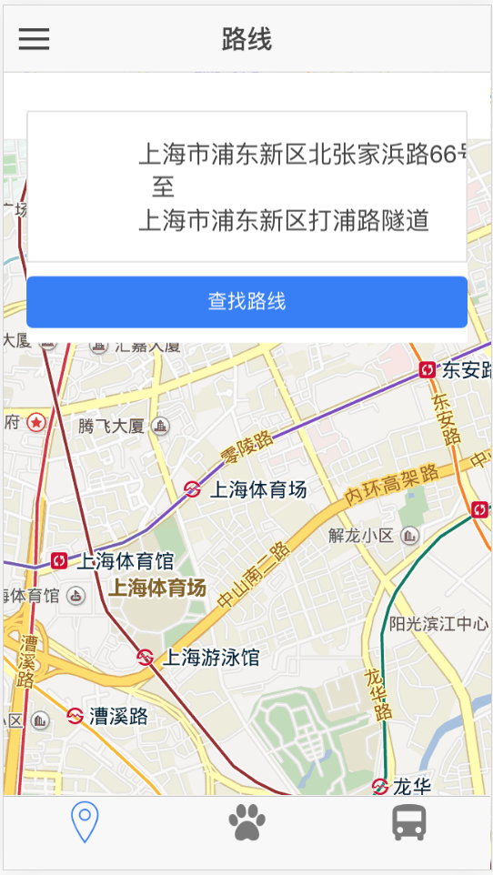
Find route
Click the find route button. Which will find all the route from where you are to where you want to go.

Slide 12
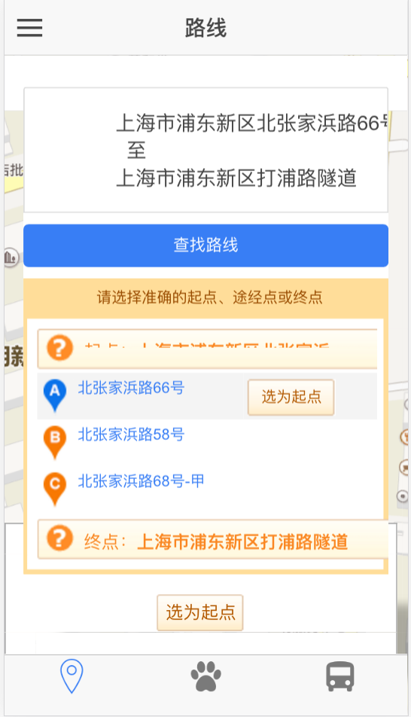
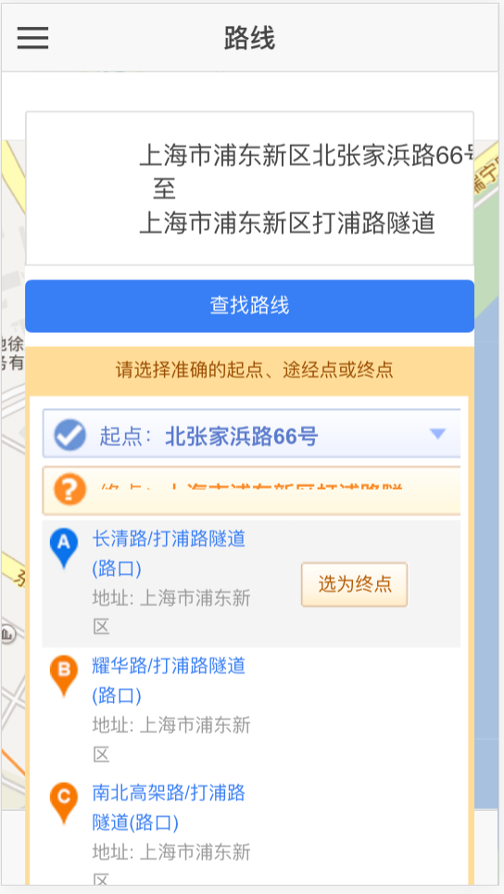
Set the location detail
You may need to set the exact location you want to go.

Slide 13
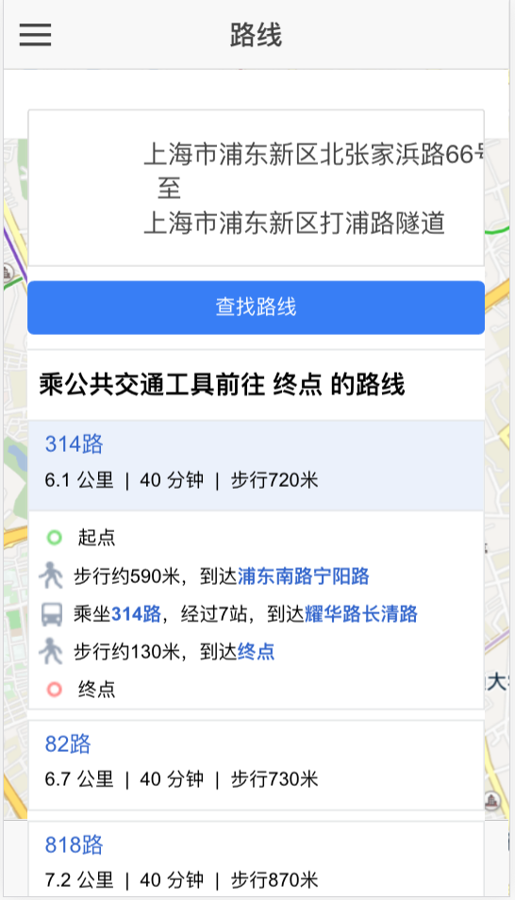
Get the route info
You will get the route info here.

Slide 14
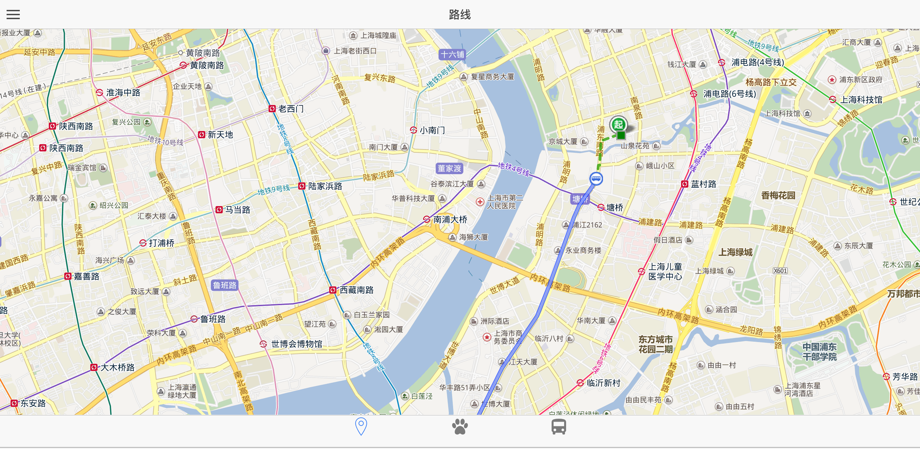
Display the route
Click the header of the route panel. It will hide the panel. And let the map show itself.

Slide 15
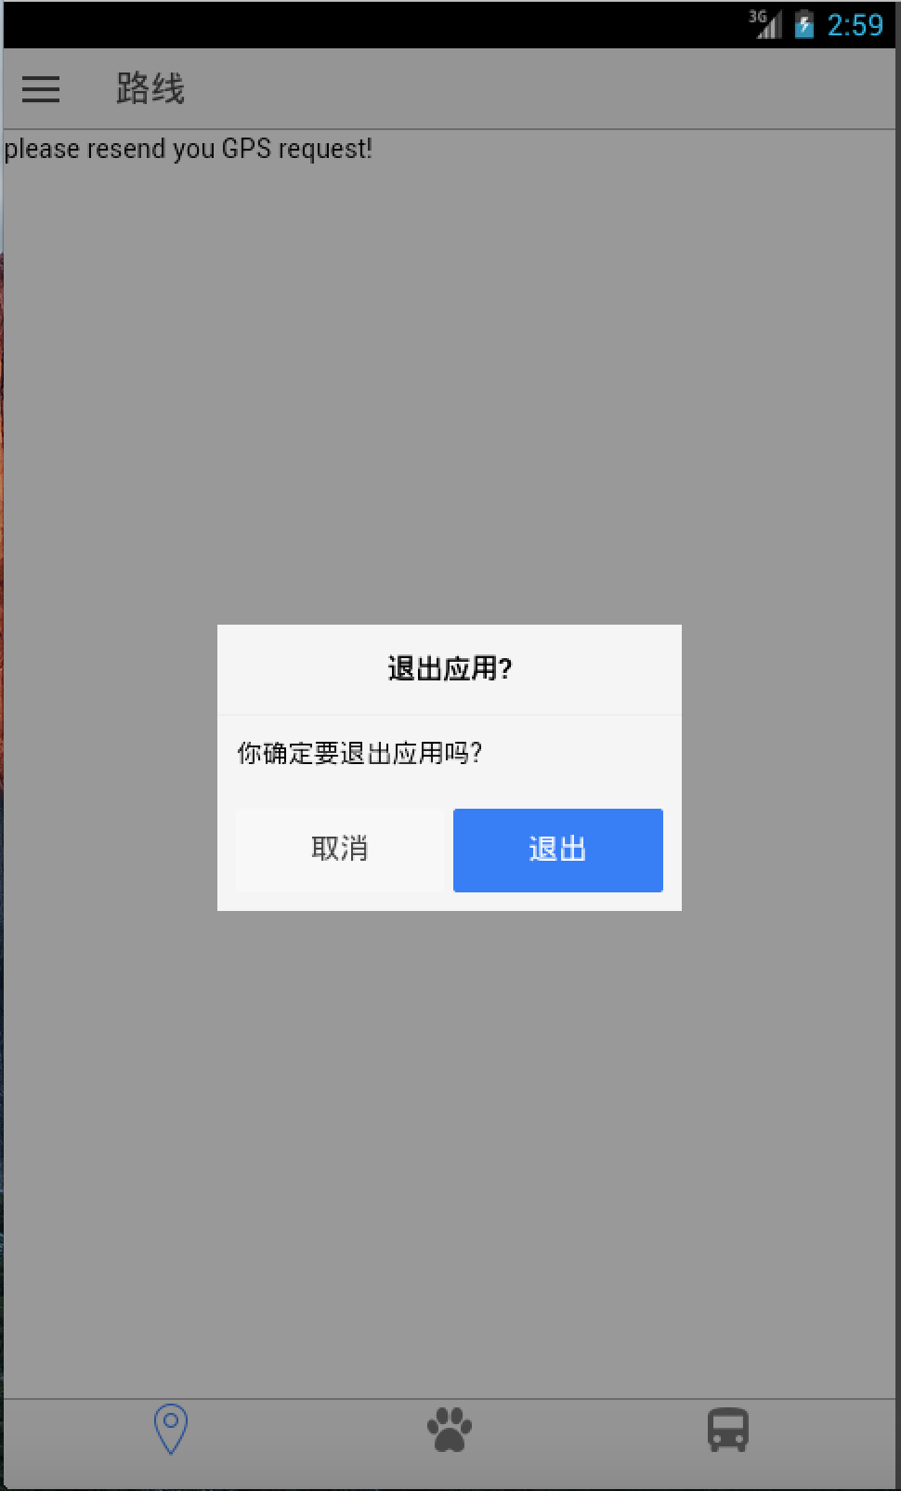
Quit
When you put the back button to the main page. And keep pushing it. It will display the quit page.

Slide 16
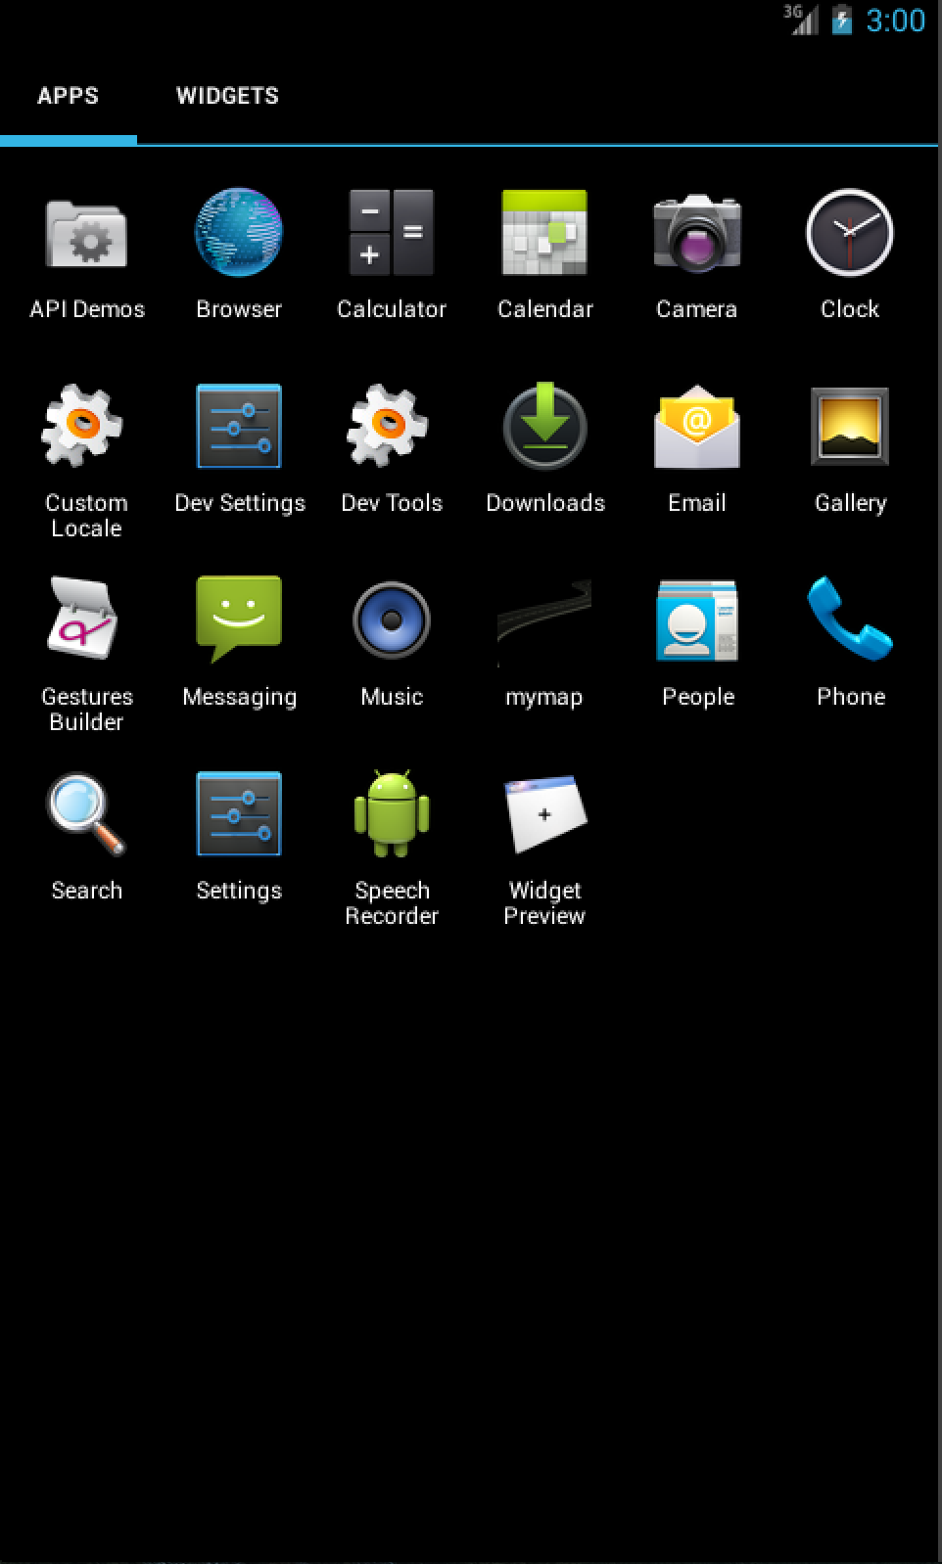
Build app result

Slide 17
Unsolved bugs.
1.when you login the application, it will save you authentication in the local storage. But when you reenter the application you need to push a button to load your authentication information. Same with user information display.
2. Quit page does’t functional when some route are trigged.
3. Baidu api doesn’t work very well with the lcoation display format.
4. the GPS module provide by angularjs don’t work very well.
5. When the location numbers too much . The storage of the phone wont be able to load the map.

Slide 18
Thanks

